Slide 1
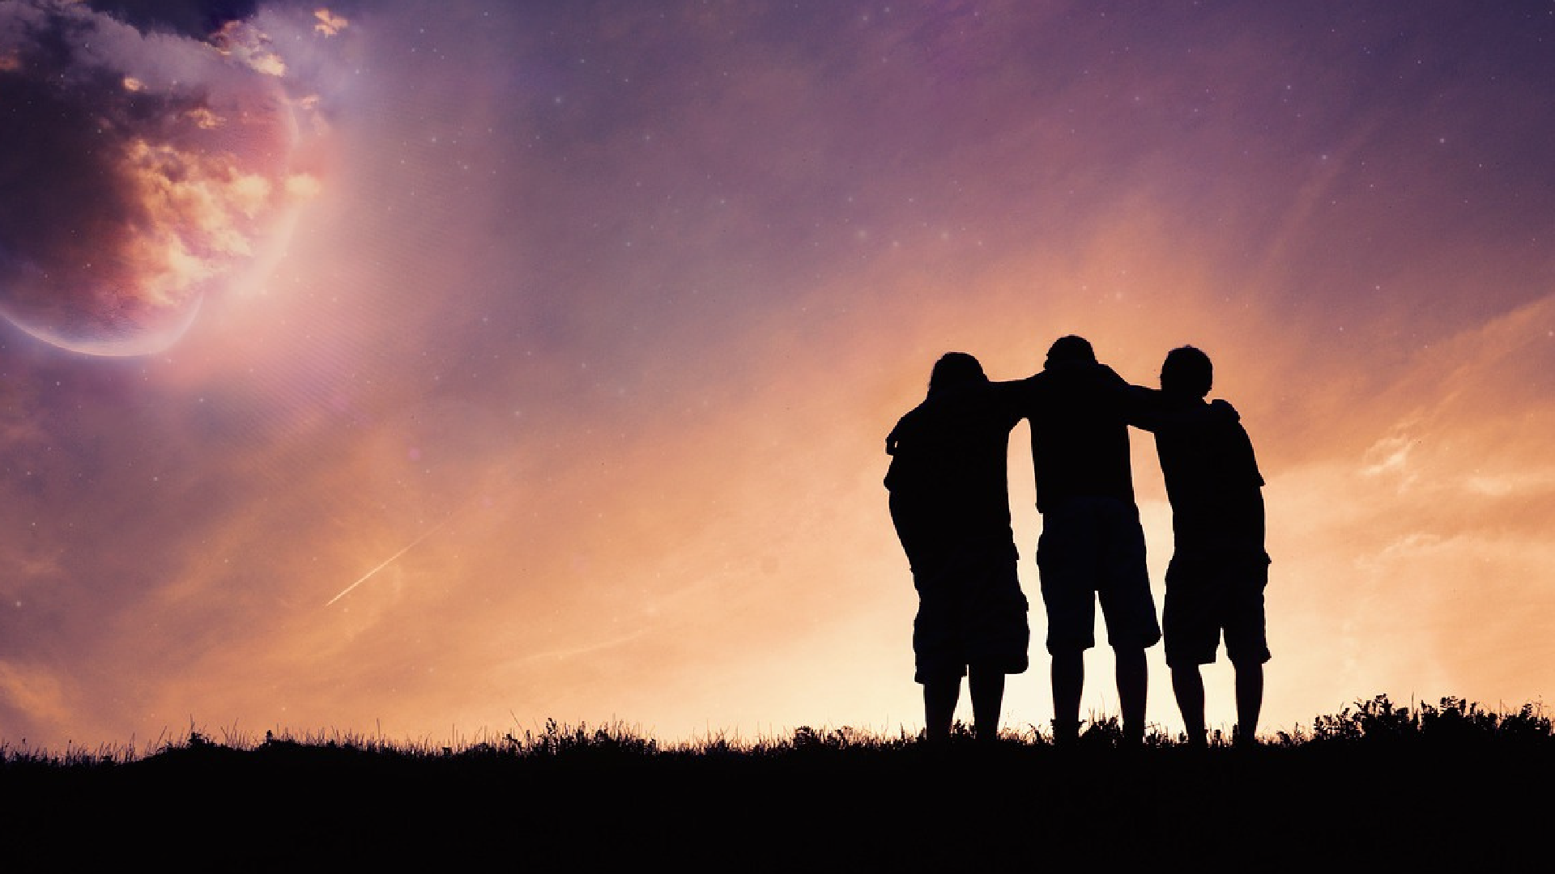

GOSPEL OF LIFE CURRICULUM
R E S O U R C E S T O S H A R E T H A T:
L I F E I S G O O D M E A N I N G F U L
V A L U A B L E

Slide 2
Gospel of Life Curriculum
Your life has meaning. Your life is good.
You are in communion with others and
have a responsibility for them.
Multimedia, interactive, life-affirming and age-appropriate
PK – 12 curriculum.

Slide 3
Gospel of Life Curriculum
Goals:
To inspire awe in the human person
To help students recognize the dignity of their own lives
To foster reverence for human life, which begins with reverence for ourselves
To provide faith-based, relevant, and positive materials on the life issues

Slide 4
Gospel of Life Curriculum
13 Topics:
Adoption
Caring for Creation
Caring for Those in Need
Celebrating Special Needs
Dignity at Every Age
Immigration
Knowing My Value
Learning to Forgive
Life is a Gift
Marriage
Overcoming Differences
Receiving Mercy
Respecting Others

Slide 5
Gospel of Life Curriculum
Content:
Lesson Plans
Activities
Discussion Questions
Prayers
Multimedia: Videos, Music, Articles
Resources
Service Opportunities

Slide 6
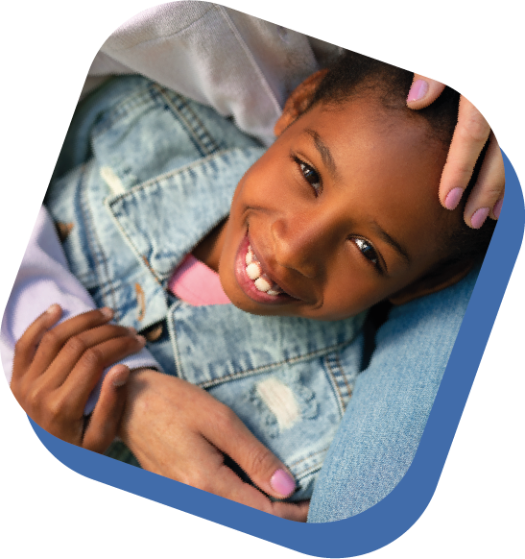
Adoption
Every child deserves a home and a family. In this lesson. students will learn about the loving choice of adoption and explore stories of people who have been adopted. Students will develop a deeper understanding of what adoption and foster care are and why, as Christians, we take very seriously the responsibility for every child born into the world.

Slide 7


Caring for Creation
Pope Francis issued the encyclical Laudato Si, the first written specifically on the environment. Students will understand the connection between honoring the dignity of each person, serving the poor and vulnerable, and protecting our environment.

Slide 8
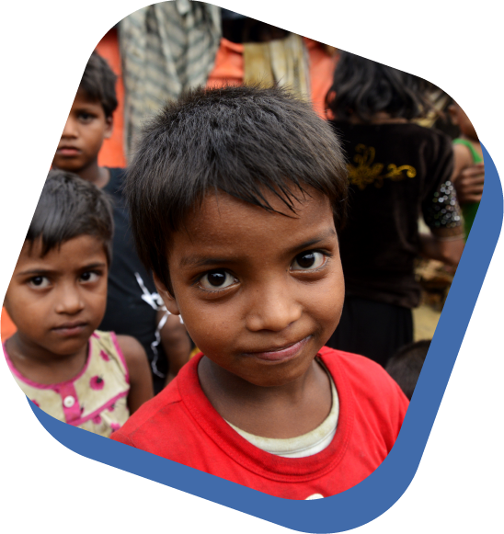
Caring for Those in Need
Pope Francis has called us to go out with the joy of the Gospel, to encounter people where they are. Like Mother Teresa, we are called to serve the poor by looking people in the eye, respecting their dignity, and engaging in works of mercy.
*Poverty Topic

Slide 9

Celebrating Special Needs
God makes each person special—a unique creation whom He planned from the beginning of time. Students are encouraged to recognize each person as a gift, regardless of their strengths, weaknesses, and limitations.

Slide 10
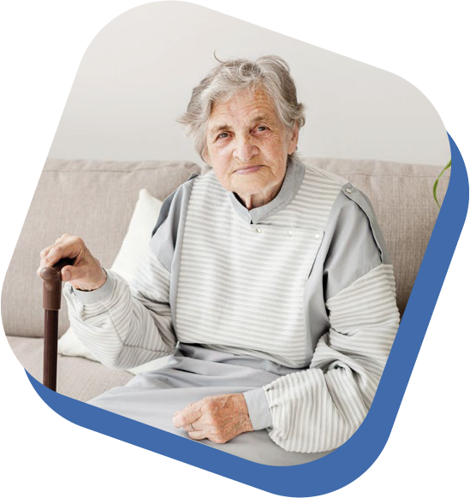
Dignity at Every Age
The international movement to legalize assisted suicide teaches that some lives are worth living while others have no value. As Christians, we embrace interdependence and understand that suffering is a necessary, if difficult, part of life. When we help others in need, we are practicing works of mercy. When we ask for help and allow others to care for us, we are providing the opportunity for others to offer mercy to us.

Slide 11
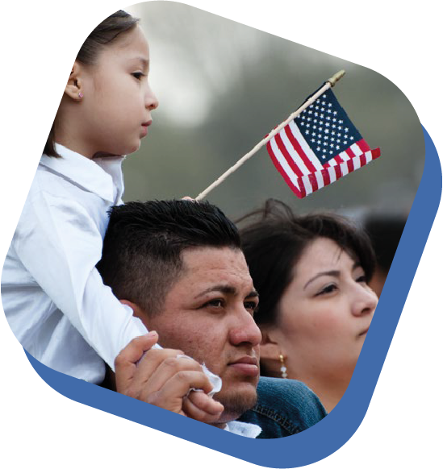
Immigration
Solidarity invites us to see immigrants through the lens of our common dignity as members of the human community. We are challenged to overcome the often volatile rhetoric of political parties and media frenzies to look at what our faith tells us about the situation. When we come to understand what motivates people to leave behind their homelands and their heritage to come to the United States, we learn that they are looking for the same things we are: peace, security, opportunity, education, and stability.

Slide 12
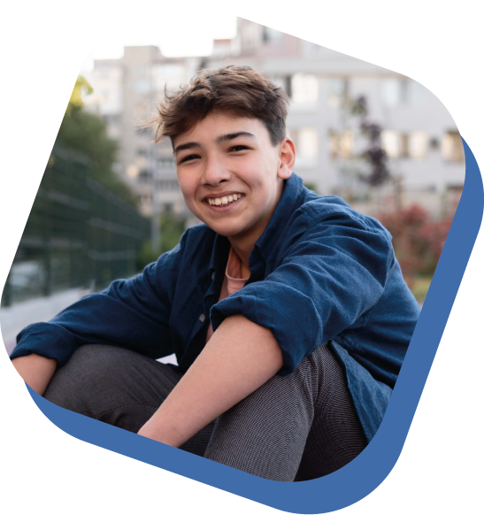
Knowing My Value
Sometimes it is easier to recognize the goodness and value of other people. It can be difficult to believe that we are good and worthy of respect. Students will learn that taking care of ourselves is part of the call to holiness. God has created us body and soul to praise him through both.
*Suicide Prevention Topic

Slide 13
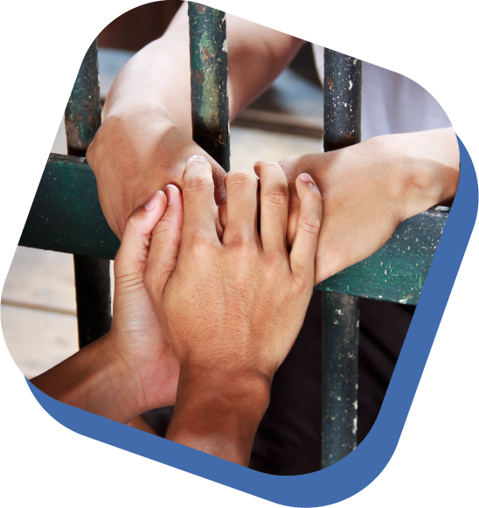
Learning to Forgive
Students will learn about the mercy of God and His invitation to us to uphold the dignity of every person, even those who have committed crimes. Bad decisions cannot destroy the reality of the love of God. Solutions to crime and punishment must take into account the dignity of every person.
*Death Penalty Topic

Slide 14
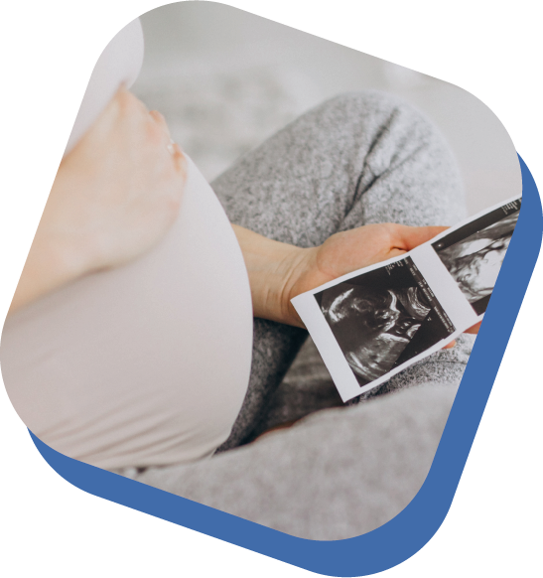
Life is a Gift
It takes far more to build a culture that welcomes and respects every human life than just talking about it or creating laws. To truly create a world where every person is loved, each individual has to do his or her share to spread kindness, mercy and an authentic understanding of being part of the human family. Only then will abortion and other attacks on human life end.

Slide 15

Marriage
By teaching the truth of marriage—a loving, permanent commitment between a man and a woman to each other and any children they may have—we allow students to realize that God did intend something special for us; that we are made for and capable of lasting, authentic love; and that even if our own human realities fall far from this ideal, they can still aspire to it as adults.​

Slide 16

Overcoming Differences
Each person is totally unrepeatable and loved into existence by God. In our world, it is so important that we learn to respect the dignity of every human person, no matter our differences.
*Racism Topic

Slide 17
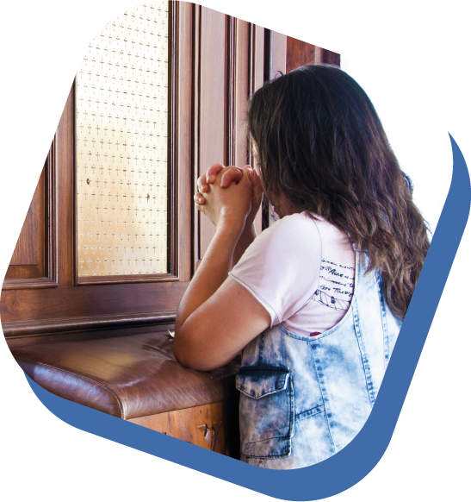
Receiving Mercy
Life is a gift but sometimes we don’t recognize the goodness of God’s plans and we choose to turn away. God is always calling us back to Himself. He invites us to receive His mercy and to extend forgiveness to others.

Slide 18
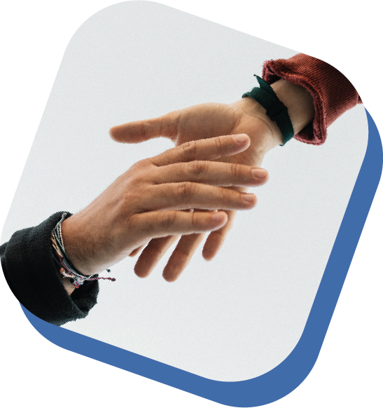
Respecting Others
Every person possesses inherent dignity. This means that persons can never be treated as objects to be used but must be respected as bearing the image of God. In this lesson, students will unpack what it means to respect others.
*Human Trafficking Topic

Slide 19
GOSPEL OF LIFE CURRICULUM
R E S O U R C E S T O S H A R E T H A T:
L I F E I S G O O D M E A N I N G F U L
V A L U A B L E

