Slide 1
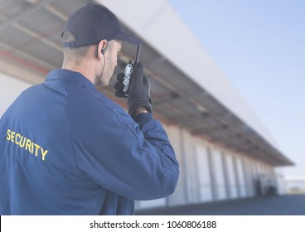
2-DAY CERTIFICATION CLASS FOR RETIRED LAW ENFORCEMENT PARISH SECURITY OFFICERS
Open to retired law enforcement personnel who are licensed to carry firearms and are registered parishioners at an Archdiocesan Parish. All attendees must be pre-approved by the parish pastor to register.
WHEN:
Monday, August 2, 5:00 - 10:00 PM
Tuesday, August 3, 5:00 – 10:00 PM
WHERE:
Saint Joachim’s School and Church,
51 Leonard Street, Beacon, NY
(Meals and Refreshments will be provided)
Please contact Frank Napolitano at frank.napolitano@archny.org (646-794-3024) to register attendees for the course. There is no charge for this training. Attendance limited to 12 per session.

