Slide 1
Catholic Charities Featured Stories
Join Team Catholic Charities!
We are excited to share that Catholic Charities has the unique opportunity to assemble a team of fifteen dedicated runners to participate in the 2022 TCS New York City Marathon! If you, or someone you know, might be interested in joining Team Catholic Charities, please fill out an application today. Space is limited for this year's marathon!
Learn more about Catholic Charities and the TCS NYC marathon.

Slide 2
Mother and infant flee Ukraine, Irpin, March 9, 2022
Standing in Solidarity with the Ukrainian people
“We stand in solidarity with the Ukrainian people, ready to participate in whatever way we can to help in resettlement efforts to the United States and New York. We have a long history of helping refugees including the people of Haiti, Central and South America, Iraq, and most recently Afghanistan,” said Msgr. Kevin Sullivan, Executive Director of Catholic Charities of the Archdiocese of New York, which serves a city that has the largest number of Ukrainian immigrants in the U.S.
Read More

Slide 3
Open Newsroom on NYC’s Rent Crisis
New York Rent Crisis Topic of Live Panel Discussion with The City, Catholic Charities New York, and Other Experts
Thousands of New Yorkers, emerging from the Covid pandemic, are behind on their rent. The Emergency Rental Assistance Program (ERAP), a state subsidy program for tenants and landlords, has helped but has been marked by slow responses and has expired. The City, an independent news organization, hosted a March 21 virtual panel on rental crisis issues facing New York tenants. Included were moderator Rachel Holliday Smith, The City journalist; Lakisha Morris, director of operations at Catholic Charities Community Services; Leah Goodridge, managing attorney for housing policy at Mobilization for Justice, and Nakeeb Siddique, director for housing at the Legal Aid Society’s Brooklyn office.
Read More

Slide 4
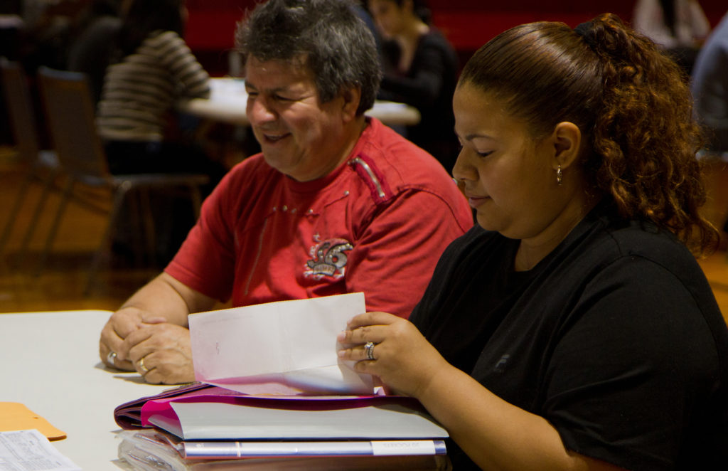
Immigration Consultation, Catholic Charities New York
International Center Preps New Citizens, Helps Immigrants Navigate American Life
Assisting applicants to pass the citizenship test is just one slice of the services offered by the International Center, located in downtown Manhattan at 80 Maiden Lane. It provides education for immigrants in the city and the Hudson Valley.
The Center, a part of Catholic Charities Community Services, has adapted to life with Covid. Zoom classes are particularly popular, as they help fit into the busy lives of students, cutting back on commuting time while also fulfilling family and work responsibilities. As a result, the remote classes will continue even if the city fully emerges into a post-Covid era.
Read More

Slide 5
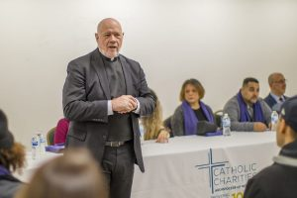
Courtesy of the Manhattan Times
Monsignor Kevin Sullivan publishes What's the Message?: Bible Basics for Busy People
“I felt the need to write the book because when God was giving out gifts, one of the things he shortchanged me on was patience,” he said. “I'm not patient and I think there are a number of other New Yorkers how are a little bit on the short side of patience.”
View on Amazon
Read More

Slide 6
catholiccharitiesny.org
Catholic Charities, Archdiocese of New York 1011 First Avenue, 11th Floor New York, NY 10022 Toll Free Help Line (888) 744-7900
©2021 Catholic Charities All rights reserved
@CatholicCharitiesNY
@CathCharitiesNY
@catholiccharitiesny
@catholiccharitiesofny

